Slide 1
Chapter 4 : Intermediate SQL

Slide 2
Outline
Join Expressions
Views
Transactions
Integrity Constraints
SQL Data Types and Schemas
Index Definition in SQL
Authorization
Notes:
1

Slide 3
Joined Relations
Join operations take two relations and return as a result another relation.
A join operation is a Cartesian product which requires that tuples in the two relations match (under some condition). It also specifies the attributes that are present in the result of the join
The join operations are typically used as subquery expressions in the from clause
Three types of joins:
  Natural join
  Inner join
  Outer join

Slide 4
Natural Join in SQL
Natural join matches tuples with the same values for all common attributes, and retains only one copy of each common column.
List the names of instructors along with the course ID of the courses that they taught
  select name, course_id
  from students, takes
  where student.ID = takes.ID;
Same query in SQL with “natural join” construct
  select name, course_id
  from student natural join takes;

Slide 5
Natural Join in SQL (Cont.)
The from clause can have multiple relations combined using natural join:
  select A₁, A₂, … A_{n}
  from r₁ natural join r₂ natural join .. natural join r_{n}
  where P ;

Slide 6
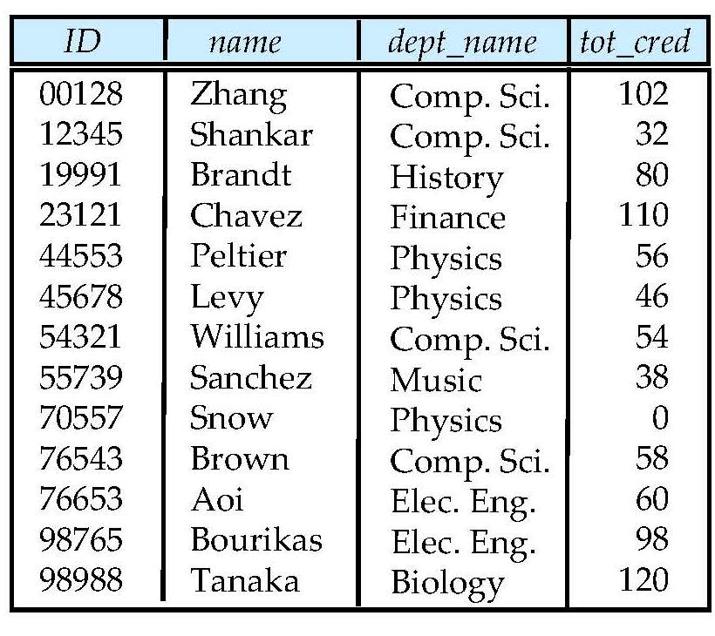
Student Relation

Slide 7
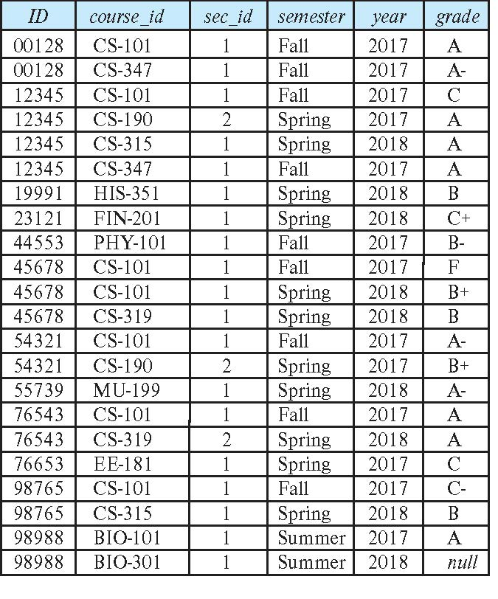
Takes Relation

Slide 8
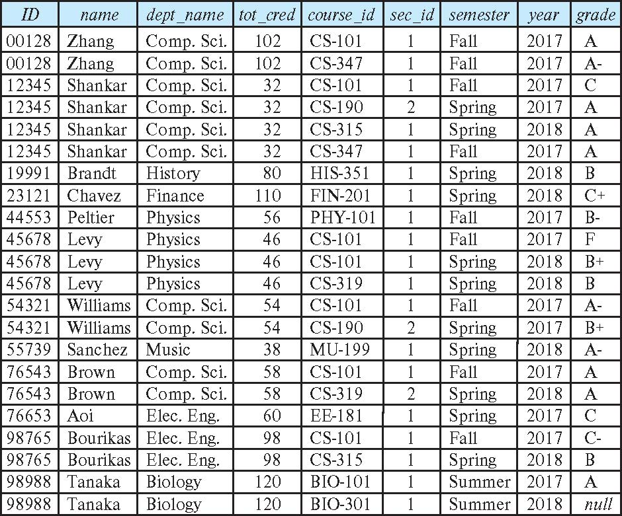
student natural join takes

Slide 9
Dangerous in Natural Join
Beware of unrelated attributes with same name which get equated incorrectly
Example -- List the names of students instructors along with the titles of courses that they have taken
  Correct version
  select name, title
  from student natural join takes, course
  where takes.course_id = course.course_id;
  Incorrect version
    select name, title
    from student natural join takes natural join course;
    This query omits all (student name, course title) pairs where the student takes a course in a department other than the student's own department.
    The correct version (above), correctly outputs such pairs.

Slide 10
Natural Join with Using Clause
To avoid the danger of equating attributes erroneously, we can use the “using” construct that allows us to specify exactly which columns should be equated.
Query example
select name, title
from (student natural join takes) join course using (course_id)

Slide 11
Join Condition
The on condition allows a general predicate over the relations being joined
This predicate is written like a where clause predicate except for the use of the keyword on
Query example
select *
from student join takes on student_ID = takes_ID
  The on condition above specifies that a tuple from student matches a tuple from takes if their ID values are equal.
Equivalent to:
select *
from student , takes
where student_ID = takes_ID

Slide 12
Join Condition (Cont.)
The on condition allows a general predicate over the relations being joined.
This predicate is written like a where clause predicate except for the use of the keyword on.
Query example
select *
from student join takes on student_ID = takes_ID
  The on condition above specifies that a tuple from student matches a tuple from takes if their ID values are equal.
Equivalent to:
select *
from student , takes
where student_ID = takes_ID

Slide 13
Outer Join
An extension of the join operation that avoids loss of information.
Computes the join and then adds tuples form one relation that does not match tuples in the other relation to the result of the join.
Uses null values.
Three forms of outer join:
  left outer join
  right outer join
  full outer join

Slide 14
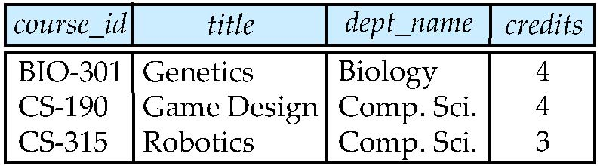
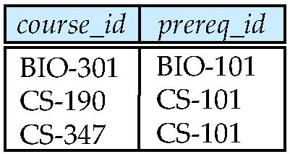
Outer Join Examples
Relation course
Relation prereq
Observe that
course information is missing CS-347
prereq information is missing CS-315

Slide 15
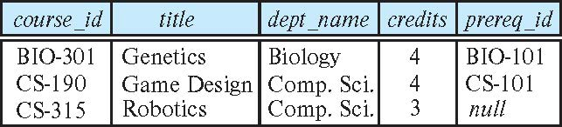
Left Outer Join
course natural left outer join prereq
  In relational algebra: course ⟕ prereq

Slide 16
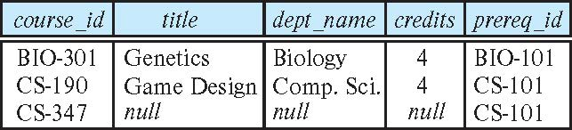
Right Outer Join
course natural right outer join prereq
  In relational algebra: course ⟖ prereq

Slide 17
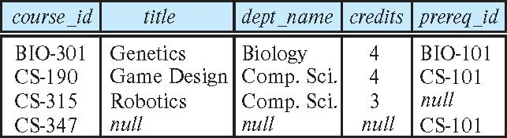
Full Outer Join
course natural full outer join prereq
In relational algebra: course ⟗ prereq

Slide 18
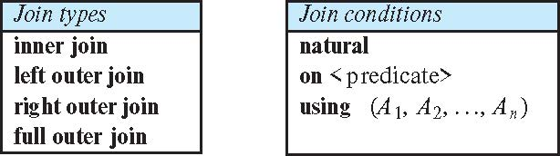
Joined Types and Conditions
Join operations take two relations and return as a result another relation.
These additional operations are typically used as subquery expressions in the from clause
Join condition – defines which tuples in the two relations match.
Join type – defines how tuples in each relation that do not match any tuple in the other relation (based on the join condition) are treated.

Slide 19
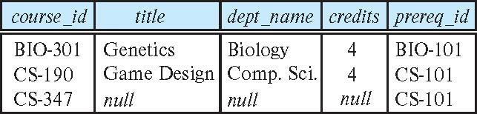
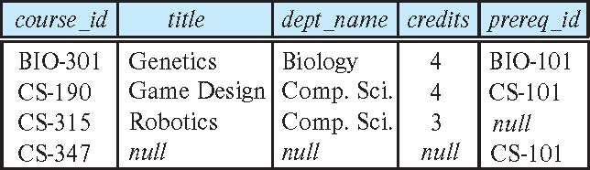
Joined Relations – Examples
course natural right outer join prereq
course full outer join prereq using (course_id)

Slide 20
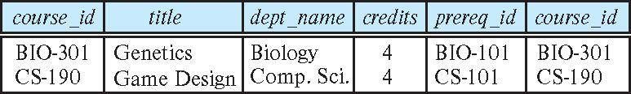
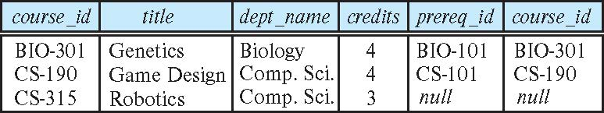
Joined Relations – Examples
course inner join prereq on
course.course_id = prereq.course_id
What is the difference between the above, and a natural join?
course left outer join prereq on
course.course_id = prereq.course_id

Slide 21
Joined Relations – Examples
course natural right outer join prereq
course full outer join prereq using (course_id)

Slide 22
Views
In some cases, it is not desirable for all users to see the entire logical model (that is, all the actual relations stored in the database.)
Consider a person who needs to know an instructors name and department, but not the salary. This person should see a relation described, in SQL, by
select ID, name, dept_name
from instructor
A view provides a mechanism to hide certain data from the view of certain users.
Any relation that is not of the conceptual model but is made visible to a user as a “virtual relation” is called a view.

Slide 23
View Definition
A view is defined using the create view statement which has the form
create view v as < query expression >
where <query expression> is any legal SQL expression. The view name is represented by v.
Once a view is defined, the view name can be used to refer to the virtual relation that the view generates.
View definition is not the same as creating a new relation by evaluating the query expression
  Rather, a view definition causes the saving of an expression; the expression is substituted into queries using the view.

Slide 24
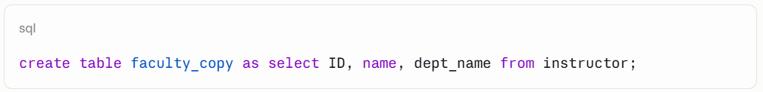
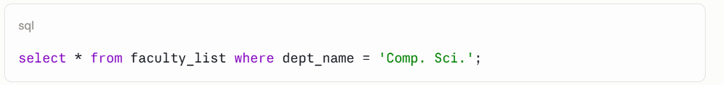
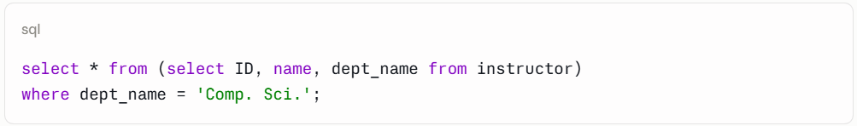
Creating Table vs Creating View
Vs

Slide 25
View Definition and Use
A view of instructors without their salary
create view faculty as
select ID, name, dept_name
from instructor
Find all instructors in the Biology department
select name
from faculty
where dept_name = 'Biology'
Create a view of department salary totals
create view departments_total_salary(dept_name, total_salary) as
select dept_name, sum (salary)
from instructor
group by dept_name;

Slide 26
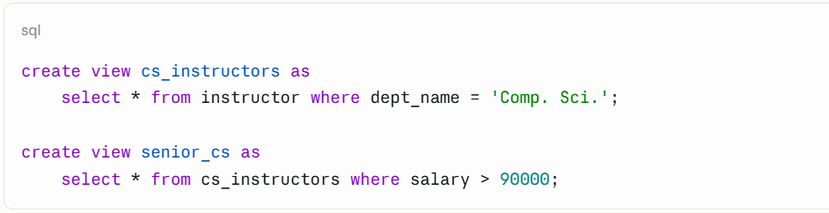
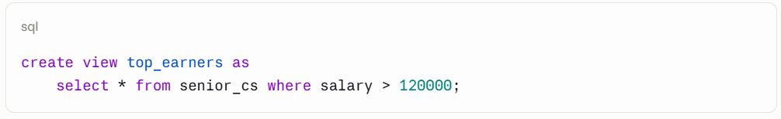
Views Defined Using Other Views
One view may be used in the expression defining another view
A view relation v₁ is said to depend directly on a view relation v₂ if v₂ is used in the expression defining v₁
A view relation v₁ is said to depend on view relation v₂ if either v₁ depends directly to v₂ or there is a path of dependencies from v₁ to v₂
A view relation v is said to be recursive if it depends on itself.

Slide 27
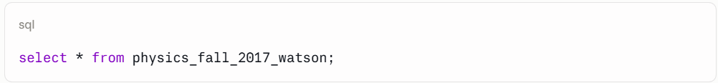
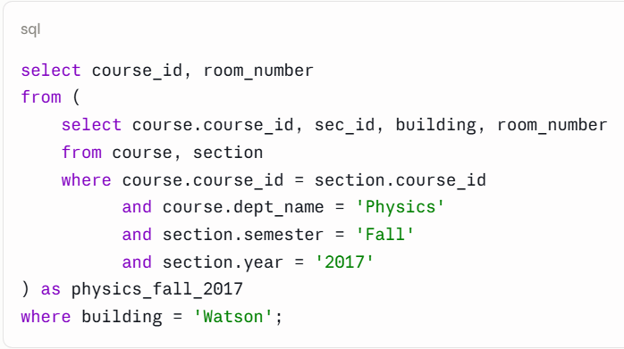
Views Defined Using Other Views
create view physics_fall_2017 as
select course.course_id, sec_id, building, room_number
from course, section
where course.course_id = section.course_id
and course.dept_name = 'Physics'
and section.semester = 'Fall'
and section.year = '2017’;
create view physics_fall_2017_watson as
select course_id, room_number
from physics_fall_2017
where building= 'Watson';

Slide 28
View Expansion
Expand the view :
create view physics_fall_2017_watson as
select course_id, room_number
from physics_fall_2017
where building= 'Watson'
To:
create view physics_fall_2017_watson as
select course_id, room_number
from (select course.course_id, building, room_number
from course, section
where course.course_id = section.course_id
and course.dept_name = 'Physics'
and section.semester = 'Fall'
and section.year = '2017')
where building= 'Watson';

Slide 29
View Expansion (Cont.)
A way to define the meaning of views defined in terms of other views.
Let view v₁ be defined by an expression e₁ that may itself contain uses of view relations.
View expansion of an expression repeats the following replacement step:
repeat
Find any view relation v_{i} in e₁
Replace the view relation v_{i} by the expression defining v_{i}
until no more view relations are present in e₁
As long as the view definitions are not recursive, this loop will terminate

Slide 30
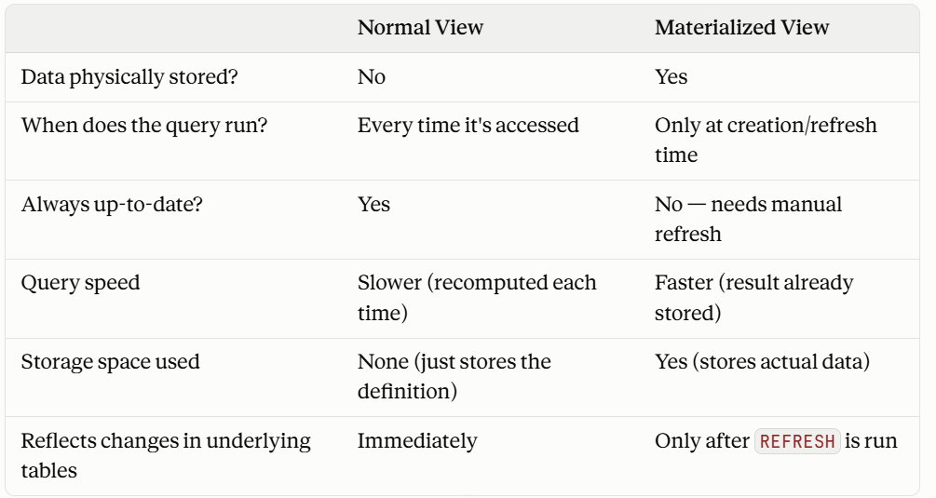
Materialized Views
Certain database systems allow view relations to be physically stored.
  Physical copy created when the view is defined.
  Such views are called Materialized view:
If relations used in the query are updated, the materialized view result becomes out of date
  Need to maintain the view, by updating the view whenever the underlying relations are updated.

Slide 31
Update of a View
Add a new tuple to faculty view which we defined earlier
insert into faculty
values ('30765', 'Green', 'Music');
This insertion must be represented by the insertion into the instructor relation
  Must have a value for salary.
Two approaches
  Reject the insert
  Insert the tuple
('30765', 'Green', 'Music', null)
into the instructor relation

Slide 32
Some Updates Cannot be Translated Uniquely
create view instructor_info as
select ID, name, building
from instructor, department
where instructor.dept_name = department.dept_name;
insert into instructor_info
values ('69987', 'White', 'Taylor');
Issues
  Which department, if multiple departments in Taylor?
  What if no department is in Taylor?

Slide 33
And Some Not at All
create view history_instructors as
select *
from instructor
where dept_name= 'History';
What happens if we insert
('25566', 'Brown', 'Biology', 100000)
into history_instructors?

Slide 34
View Updates in SQL
Most SQL implementations allow updates only on simple views
  The from clause has only one database relation.
  The select clause contains only attribute names of the relation, and does not have any expressions, aggregates, or distinct specification.
  Any attribute not listed in the select clause can be set to null
  The query does not have a group by or having clause.

Slide 35
Transactions
A transaction consists of a sequence of query and/or update statements and is a “unit” of work
The SQL standard specifies that a transaction begins implicitly when an SQL statement is executed.
The transaction must end with one of the following statements:
  Commit work. The updates performed by the transaction become permanent in the database.
  Rollback work. All the updates performed by the SQL statements in the transaction are undone.
Atomic transaction
  either fully executed or rolled back as if it never occurred
Isolation from concurrent transactions

Slide 36
Integrity Constraints
Integrity constraints guard against accidental damage to the database, by ensuring that authorized changes to the database do not result in a loss of data consistency.
  A checking account must have a balance greater than $10,000.00
  A salary of a bank employee must be at least $4.00 an hour
  A customer must have a (non-null) phone number

Slide 37
Constraints on a Single Relation
not null
primary key
unique
check (P), where P is a predicate

Slide 38
Not Null Constraints
not null
  Declare name and budget to be not null
name varchar(20) not null
budget numeric(12,2) not null

Slide 39
Unique Constraints
unique ( A₁, A₂, …, A_{m})
  The unique specification states that the attributes A₁, A₂, …, A_{m} form a candidate key.
  Candidate keys are permitted to be null (in contrast to primary keys).

Slide 40
The check clause
The check (P) clause specifies a predicate P that must be satisfied by every tuple in a relation.
Example: ensure that semester is one of fall, winter, spring or summer
create table section
(course_id varchar (8),
sec_id varchar (8),
semester varchar (6),
year numeric (4,0),
building varchar (15),
room_number varchar (7),
time slot id varchar (4),
primary key (course_id, sec_id, semester, year),
check (semester in ('Fall', 'Winter', 'Spring', 'Summer')))

Slide 41
Referential Integrity
Ensures that a value that appears in one relation for a given set of attributes also appears for a certain set of attributes in another relation.
  Example: If “Biology” is a department name appearing in one of the tuples in the instructor relation, then there exists a tuple in the department relation for “Biology”.
Let A be a set of attributes. Let R and S be two relations that contain attributes A and where A is the primary key of S. A is said to be a foreign key of R if for any values of A appearing in R these values also appear in S.

Slide 42
Referential Integrity (Cont.)
Foreign keys can be specified as part of the SQL create table statement
foreign key (dept_name) references department
By default, a foreign key references the primary-key attributes of the referenced table.
SQL allows a list of attributes of the referenced relation to be specified explicitly.
foreign key (dept_name) references department (dept_name)

Slide 43
Cascading Actions in Referential Integrity
When a referential-integrity constraint is violated, the normal procedure is to reject the action that caused the violation.
An alternative, in case of delete or update is to cascade
create table course (
(…
dept_name varchar(20),
foreign key (dept_name) references department
on delete cascade
on update cascade,
. . .)
Instead of cascade we can use :
  set null,
  set default

Slide 44
Integrity Constraint Violation During Transactions
Consider:
  create table person (
  ID char(10),
  name char(40),
  mother char(10),
  father char(10),
  primary key ID,
  foreign key father references person,
  foreign key mother references person)
How to insert a tuple without causing constraint violation?
  Insert father and mother of a person before inserting person
  OR, set father and mother to null initially, update after inserting all persons (not possible if father and mother attributes declared to be not null)
  OR defer constraint checking

Slide 45
Complex Check Conditions
The predicate in the check clause can be an arbitrary predicate that can include a subquery.
check (time_slot_id in (select time_slot_id from time_slot))
The check condition states that the time_slot_id in each tuple in the section relation is actually the identifier of a time slot in the time_slot relation.
  The condition has to be checked not only when a tuple is inserted or modified in section , but also when the relation time_slot changes

Slide 46
Assertions
An assertion is a predicate expressing a condition that we wish the database always to satisfy.
The following constraints, can be expressed using assertions:
For each tuple in the student relation, the value of the attribute tot_cred must equal the sum of credits of courses that the student has completed successfully.
An instructor cannot teach in two different classrooms in a semester in the same time slot
An assertion in SQL takes the form:
create assertion <assertion-name> check (<predicate>);

Slide 47
What Is an Assertion?
A predicate expressing a condition the database must always satisfy
More powerful than a table CHECK constraint — can span multiple relations
Example: a student's tot_cred must equal the sum of credits of completed courses
Example: an instructor cannot teach in two classrooms in the same time slot
create assertion <assertion-name>
check (<predicate>);

Slide 48
Example — Enforcing tot_cred Correctness
Uses NOT EXISTS so the assertion holds only if no student violates the rule
Inner query recomputes the “correct” credit total from completed courses
create assertion credits_earned_constraint
check (
not exists (
select ID
from student
where tot_cred <> (
select coalesce(sum(credits), 0)
from takes natural join course
where student.ID = takes.ID
and grade is not null
and grade <> 'F'
)
)
);

Slide 49
Built-in Data Types in SQL
date: Dates, containing a (4 digit) year, month and date
  Example: date '2005-7-27'
time: Time of day, in hours, minutes and seconds.
  Example: time '09:00:30' time '09:00:30.75'
timestamp: date plus time of day
  Example: timestamp '2005-7-27 09:00:30.75'
interval: period of time
  Example: interval '1' day
  Subtracting a date/time/timestamp value from another gives an interval value
  Interval values can be added to date/time/timestamp values

Slide 50
Large-Object Types
Large objects (photos, videos, CAD files, etc.) are stored as a large object:
  blob: binary large object -- object is a large collection of uninterpreted binary data (whose interpretation is left to an application outside of the database system)
  clob: character large object -- object is a large collection of character data
When a query returns a large object, a pointer is returned rather than the large object itself.

Slide 51
DATA TYPES
Large-Object Types — BLOB & CLOB
Used for photos, videos, CAD files, and other large or non-traditional data
blob (Binary Large Object) — uninterpreted binary data; the application, not the DBMS, interprets it
clob (Character Large Object) — a large collection of character/text data
A query returns a pointer to the large object, not the object itself
create table employee (
id varchar(5),
photo blob, -- raw binary image data
resume clob -- long text document
);

Slide 52
User-Defined Types
create type construct in SQL creates user-defined type
  create type Dollars as numeric (12,2) final
Example:
create table department
(dept_name varchar (20),
building varchar (15),
budget Dollars);

Slide 53
DATA TYPES
User-Defined Types — CREATE TYPE
create type gives a meaningful name to an existing base type
final — the type cannot be extended/inherited by another type
Improves readability and prevents accidentally mixing incompatible values
create type Dollars as numeric(12,2) final;
create table department (
dept_name varchar(20),
building varchar(15),
budget Dollars
);

Slide 54
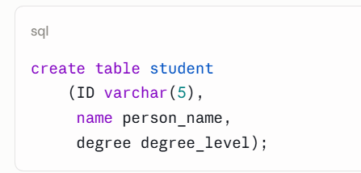
Domains
create domain construct in SQL-92 creates user-defined domain types
  create domain person_name char(20) not null
Types and domains are similar. Domains can have constraints, such as not null, specified on them.
Example:
create domain degree_level varchar(10)
constraint degree_level_test
check (value in ('Bachelors', 'Masters', 'Doctorate'));

Slide 55
Index Creation
Many queries reference only a small proportion of the records in a table.
It is inefficient for the system to read every record to find a record with particular value
An index on an attribute of a relation is a data structure that allows the database system to find those tuples in the relation that have a specified value for that attribute efficiently, without scanning through all the tuples of the relation.
We create an index with the create index command
create index <name> on <relation-name> (attribute);

Slide 56
INDEXES
Why & How We Create Indexes
Many queries reference only a small proportion of the records in a table
Without an index the system must scan every record to find a match — inefficient
An index is a data structure that lets the DBMS locate matching tuples directly, without scanning the whole relation
create index <name> on <relation-name> (attribute);

Slide 57
Index Creation Example
create table student
(ID varchar (5),
name varchar (20) not null,
dept_name varchar (20),
tot_cred numeric (3,0) default 0,
primary key (ID))
create index studentID_index on student(ID)
The query:
select *
from student
where ID = '12345'
can be executed by using the index to find the required record, without looking at all records of student

Slide 58
Authorization
We may assign a user several forms of authorizations on parts of the database.
  Read - allows reading, but not modification of data.
  Insert - allows insertion of new data, but not modification of existing data.
  Update - allows modification, but not deletion of data.
  Delete - allows deletion of data.
Each of these types of authorizations is called a privilege. We may authorize the user all, none, or a combination of these types of privileges on specified parts of a database, such as a relation or a view.

Slide 59
Authorization (Cont.)
Forms of authorization to modify the database schema
  Index - allows creation and deletion of indices.
  Resources - allows creation of new relations.
  Alteration - allows addition or deletion of attributes in a relation.
  Drop - allows deletion of relations.

Slide 60
AUTHORIZATION
Schema-Level Privileges
Index — allows creation and deletion of indices
Resources — allows creation of new relations
Alteration — allows addition or deletion of attributes in a relation
Drop — allows deletion of relations
Typically reserved for the database administrator, not ordinary users
create index studentID_index on student(ID); -- Index
create table new_relation ( ... ); -- Resources
alter table student add column phone varchar(15); -- Alteration
drop table old_relation; -- Drop

Slide 61
Authorization Specification in SQL
The grant statement is used to confer authorization
grant <privilege list> on <relation or view > to <user list>
<user list> is:
  a user-id
  public, which allows all valid users the privilege granted
  A role (more on this later)
Example:
  grant select on department to Amit, Satoshi
Granting a privilege on a view does not imply granting any privileges on the underlying relations.
The grantor of the privilege must already hold the privilege on the specified item (or be the database administrator).

Slide 62
Privileges in SQL
select: allows read access to relation, or the ability to query using the view
  Example: grant users U₁, U₂, and U₃ select authorization on the instructor relation:
grant select on instructor to U₁, U₂, U₃
insert: the ability to insert tuples
update: the ability to update using the SQL update statement
delete: the ability to delete tuples.
all privileges: used as a short form for all the allowable privileges

Slide 63
AUTHORIZATION
The GRANT Statement
grant <privilege list> on <relation or view> to <user list>
<user list> can be: a user-id, public (all valid users), or a role
Granting a privilege on a view does not grant any privilege on the underlying relations
The grantor must already hold the privilege (or be the database administrator)
grant <privilege list> on <relation or view> to <user list>;
grant select on department to Amit, Satoshi;

Slide 64
AUTHORIZATION
Data-Level Privileges
Read — allows reading, but not modification of data
Insert — allows insertion of new data, but not modification of existing data
Update — allows modification, but not deletion of data
Delete — allows deletion of data
Each type of authorization is called a privilege; a user may hold any combination
grant select on student to clerk1;
grant select, insert on takes to clerk1;

Slide 65
Revoking Authorization in SQL
The revoke statement is used to revoke authorization.
  revoke <privilege list> on <relation or view> from <user list>
Example:
  revoke select on student from U₁, U₂, U₃
<privilege-list> may be all to revoke all privileges the revokee may hold.
If <revokee-list> includes public, all users lose the privilege except those granted it explicitly.
If the same privilege was granted twice to the same user by different grantees, the user may retain the privilege after the revocation.
All privileges that depend on the privilege being revoked are also revoked.

Slide 66
AUTHORIZATION
The REVOKE Statement
revoke <privilege list> on <relation or view> from <user list>
<privilege list> may be all, to revoke every privilege the revokee holds
Revoking from public still leaves users who were granted the privilege explicitly
All privileges that depend on the revoked privilege are also revoked (cascades)
revoke select on student from U1, U2, U3;
revoke select on student from public;
revoke all on student from U1;

Slide 67
Roles
A role is a way to distinguish among various users as far as what these users can access/update in the database.
To create a role we use:
create a role <name>
Example:
  create role instructor
Once a role is created we can assign “users” to the role using:
  grant <role> to <users>

Slide 68
Roles Example
create role instructor;
grant instructor to Amit;
Privileges can be granted to roles:
  grant select on takes to instructor;
Roles can be granted to users, as well as to other roles
  create role teaching_assistant
  grant teaching_assistant to instructor;
    Instructor inherits all privileges of teaching_assistant
Chain of roles
  create role dean;
  grant instructor to dean;
  grant dean to Satoshi;

Slide 69
AUTHORIZATION
Roles — Grouping Privileges
A role distinguishes among users by what they can access/update in the database
Privileges are granted to the role once; the role is then granted to any number of users
Roles can be granted to users, as well as to other roles
create role instructor;
grant select on takes to instructor;
grant instructor to Amit, Satoshi, Ali;

Slide 70
AUTHORIZATION
Roles Example — Chain of Roles
A role granted to another role builds an inheritance chain
A user inherits every privilege of every role below it in the chain
create role instructor; grant instructor to Amit;
grant select on takes to instructor;
create role teaching_assistant;
grant teaching_assistant to instructor;
-- instructor now inherits all privileges of teaching_assistant
create role dean;
grant instructor to dean; grant dean to Satoshi;
-- Satoshi inherits: dean -> instructor -> teaching_assistant

Slide 71
Authorization on Views
create view geo_instructor as
(select *
from instructor
where dept_name = 'Geology');
grant select on geo_instructor to geo_staff
Suppose that a geo_staff member issues
  select *
  from geo_instructor;
What if
  geo_staff does not have permissions on instructor?
  Creator of view did not have some permissions on instructor?

Slide 72
AUTHORIZATION
Authorization on Views
A user can query a view without holding a direct privilege on the underlying table
Access is granted “on behalf of” the view's creator and their own permissions
If the creator's access to the underlying relation is later reduced, the view can break
create view geo_instructor as
(select * from instructor where dept_name = 'Geology');
grant select on geo_instructor to geo_staff;
-- geo_staff can run this, with no direct privilege on instructor:
select * from geo_instructor;

Slide 73
Other Authorization Features
references privilege to create foreign key
  grant reference (dept_name) on department to Mariano;
  Why is this required?
transfer of privileges
  grant select on department to Amit with grant option;
  revoke select on department from Amit, Satoshi cascade;
  revoke select on department from Amit, Satoshi restrict;
  And more!

Slide 74
AUTHORIZATION
References, Grant Option & Revoke Modes
references — required to create a foreign key referencing another user's table
with grant option — lets the grantee re-grant the privilege to others
cascade — revoking also revokes everything granted downstream from it
restrict — blocks the revoke instead of letting it cascade
grant reference (dept_name) on department to Mariano;
grant select on department to Amit with grant option;
revoke select on department from Amit, Satoshi cascade;
revoke select on department from Amit, Satoshi restrict;

Slide 75
End of Chapter 4

